Slide 1
Restaurant Analysis of Swiggy
SHRI JEY SURYA K | MBE 11

Slide 2
Project objective
Objective:
To analyze and visualize restaurant data using Power BI to create interactive dashboards that provide actionable insights that helps us for decision-making.

Slide 3
Findings and Insights:
As we analyzed the price distribution of restaurants, it is seen that the distribution is positively skewed, which means the mean (average price) is greater than the median.
Calculating the correlation co-efficient between price, total rating, delivery time and average ratings, we could identify that there is positive correlation between price and average rating of +0.11%
We could also identify that there is positive correlation between total ratings and average rating of +0.16%
Delivery time is negatively correlated with the average rating (-0.15%)
Total restaurants are 7865 and about 662 restaurants are top rated restaurants (above 4.5 average ratings).

Slide 4
Recommendations:
Delivery time should be improved in Pune, Chennai and Kolkata by identify areas with longer delivery times and adjust routing strategies.
Adjusting pricing during off-peak hours to boost sales.
High-margin restaurants should be promoted more aggressively on the app.
Highlighting Top-Rated Restaurants to drive more orders.
Work with restaurants to identify items that take less time to prepare and promote these during busy periods to reduce overall delivery time.

Slide 5
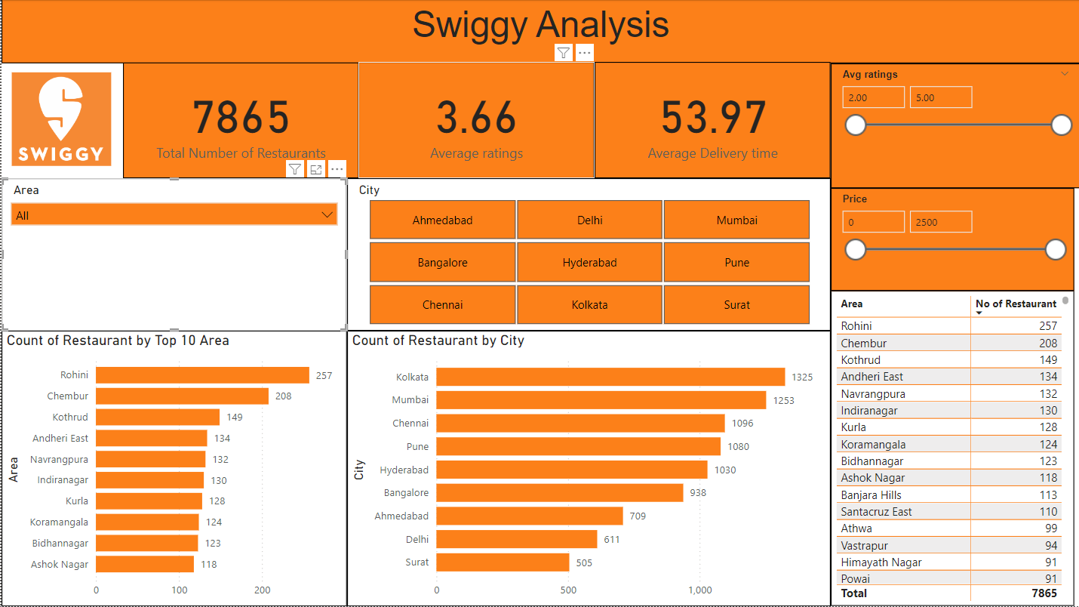

Slide 6
Thank You!

